Slide 1
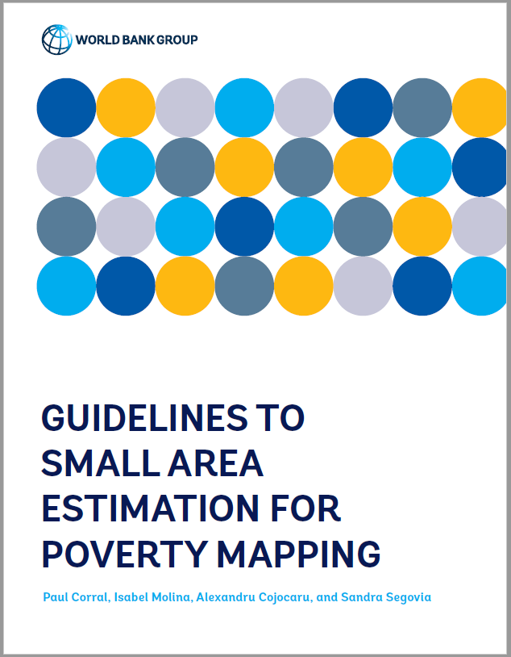
Guidelines to small area estimation for poverty mapping
Poverty and Equity Global Practice
…with upcoming work with Henderson, Segovia, and McGee

Slide 2
The following materials have been produced under GSG1’s guidance and quality control
Reference material and trainings
Guidelines online: https://ssegoviajuarez.github.io/sae/00_welcome.html
Guidelines pdf: https://openknowledge.worldbank.org/handle/10986/37728
WB Summer University Training: https://github.com/pcorralrodas/wb_sae_training
Stata codes for SAE
Unit-level (EB and ELL): https://github.com/pcorralrodas/SAE-Stata-Package
Fay-Herriot: https://github.com/jpazvd/fhsae

Slide 3
The guidelines also assist with the suggested quality control process for poverty maps
While doing the maps we are always available for consultations and advice
Once done, it’s recommended teams submit their report and codes for review
Since methods have changed, it’s important we get the methodology sections right, and that models and assumptions are fully checked
There is a set of people within the Poverty GP who can serve as reviewers
Individual teams are usually asked to cover the reviewer’s times
Deviations from recommendations require proper justification and validation
All caveats noted for the methodology should be stated

Slide 4

Small Area Estimation
Unit level models

Slide 5
Introduction
Earliest attempt is by Hentschel, Lanjouw, Lanjouw, and Poggi (2000) but earliest working paper is from 1998
The welfare distribution is simulated in the census data based on parameters estimated using household survey data which has detailed information on welfare
Simulating the full welfare distribution allows for estimates beyond just poverty and mean welfare for a given area.
Elbers, Lanjouw and Lanjouw (ELL - 2003) – considerer random location effects
Molina and Rao (2010) improve upon ELL and incorporate the area level information from the survey to achieve Empirical Best (EB) estimates
EB estimation ensures that the dependent variable’s mean in each area is EBLUP, but doesn’t guarantee the same for poverty
Also applied a parametric bootstrap aligned to the assumptions

Slide 6
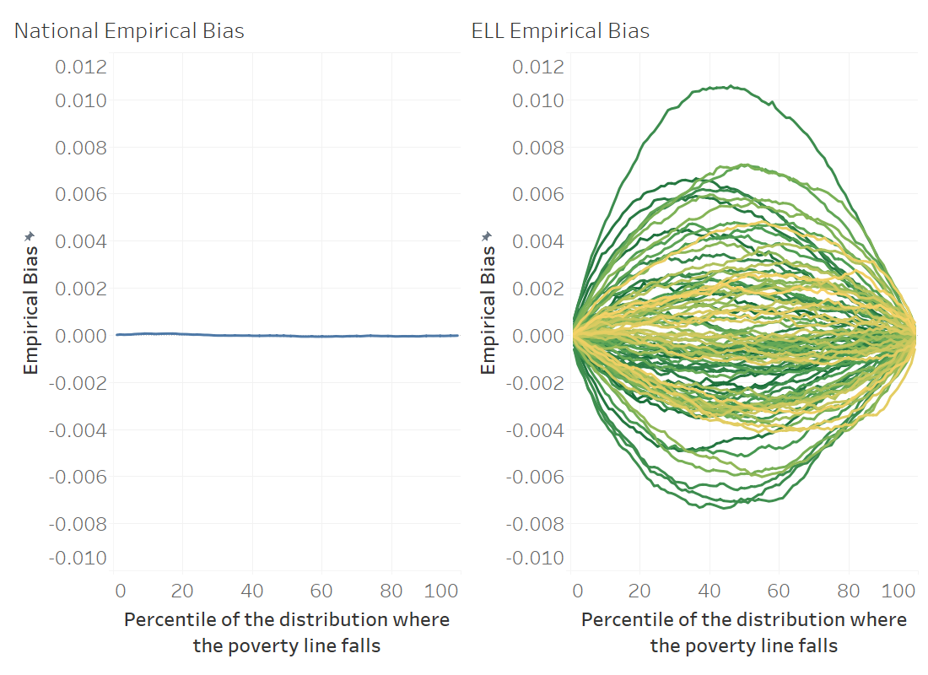
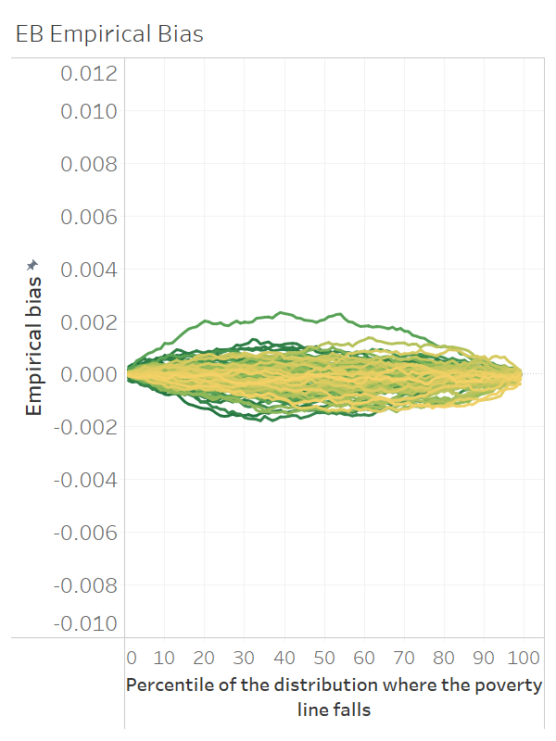
How do EB methods improve upon ELL methods?
EB ensures predictions of the dependent variable at the area level are aligned to the survey – best information at hand
At the national level (left) the ELL model works well and predicts poverty accurately across the welfare distribution
At the area level, because of the lack of EB, the method is less reliable and predictions for a given area show more bias than EB which leads to larger MSE
ELL and EB results from simulation where headcount poverty estimates are obtained under 99 different poverty lines covering the 99 percentiles of the simulated welfare distribution. On the figures to the right, each green to yellow line corresponds to one of the areas where estimates are obtained.
Notes:
How do EB methods improve upon ELL methods?
The improvement of EB methods over ELL is realized due to the conditioning of location effects on survey-based means. In very layperson terms imagine you have two areas where all characteristics are exactly the same, but have different welfare levels, then under ELL the area’s predicted welfare level and poverty rate for both areas will be the same but under EB the additional information is incorporated and thus the areas will have different predicted welfare values and poverty rates.
In these simulations we fit 1000 different models, under each model we obtain small area estimates for 100 poverty lines corresponding to the first population’s percentiles. The X axis corresponds to the poverty line used, and the lines correspond to each of the given areas. I focus on areas, because at the end of the day we want to get accurate estimates at the area level.
On the figure on the left we see that ELL does an excellent job at the NATIONAL level of predicting poverty across all lines
The figure in the middle shows how ELL is not great across areas.
The figure on the right shows how conditioning on the survey sample improves the area level predictions by a considerable amount. There are a few other important reasons why we discourage the use of povmap and you can see those in the guidelines.

Slide 7
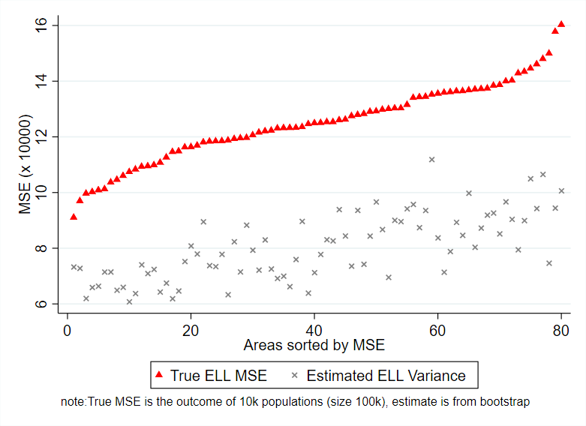
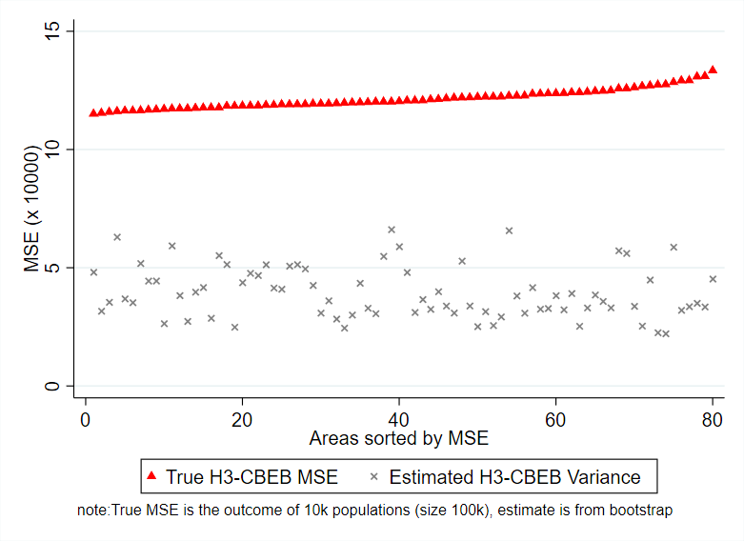
Also, due to the MI type of approach used in PovMap the noise of ELL and EB estimates was underestimated
See Corral, Molina, Nguyen (2021) for more details

Slide 8
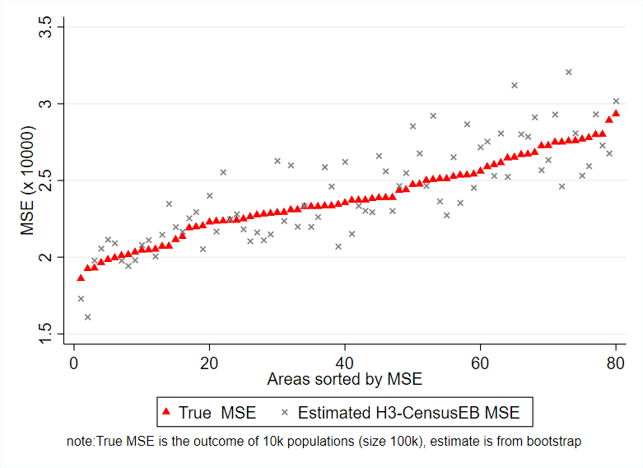
The MSE estimates from the parametric bootstrap (Gonzales-Manteiga et al. 2008) used for the CensusEB, EB, and Two-Fold models in the updated Stata sae package are aligned to the empirical MSE
See Corral, Molina, Nguyen (2021) for more details

Slide 9
In conclusion…
The Guidelines recommend teams avoid using PovMap
Teams should not apply PovMap’s implementation of EB
Earlier work has shown this to be flawed and yields biased estimates
Teams are recommended to apply EB methods
Where ELL is possible, EB is also be possible and preferred
Teams should use Stata’s sae package or R’s sae or EMDI library
See Corral, Molina, Nguyen (2021) for more details

Slide 10
Small Area Estimation
Off-census years

Slide 11
Fay Herriot models are the traditional approach for cases where access to microdata is not possible or when the census and survey are not aligned
Fay Herriot models were introduced to estimate mean per capita income in small areas in the USA (Fay and Herriot 1979)
The method consists of modelling poverty rates (or other indicators) at the area level
The resulting estimate is a weighted average between the direct estimates (those derived directly from the survey) and the model-based estimates
The weight given to each estimate in a given area depend on the sample size for that area and the quality of the model
For areas not in the sample we rely solely on the model-based estimates
Because the model is only fit on sampled areas as opposed to households, the estimates obtained are often much less efficient than those obtained under unit-level models
Notes:
Fay Herriot in 1979 introduced a model for small area estimation. The model was initially used to estimate mean per capita income in small areas, counties if I’m not mistaken, in the US
For poverty mapping the method models area level poverty rates using area level covariates, so the number of observations is much lower than those of the recently discussed models. Since less information is embedded in the models they tend to be less efficient.
Empirical best estimates are obtained in the model through taking a weighted average between the survey estimates for a given area and the model based estimate (XB). The weights are determined by the quality of the model and on the sample’s quality for that area.
So how do Fay-Herriot models perform when compared to the previous models?

Slide 12
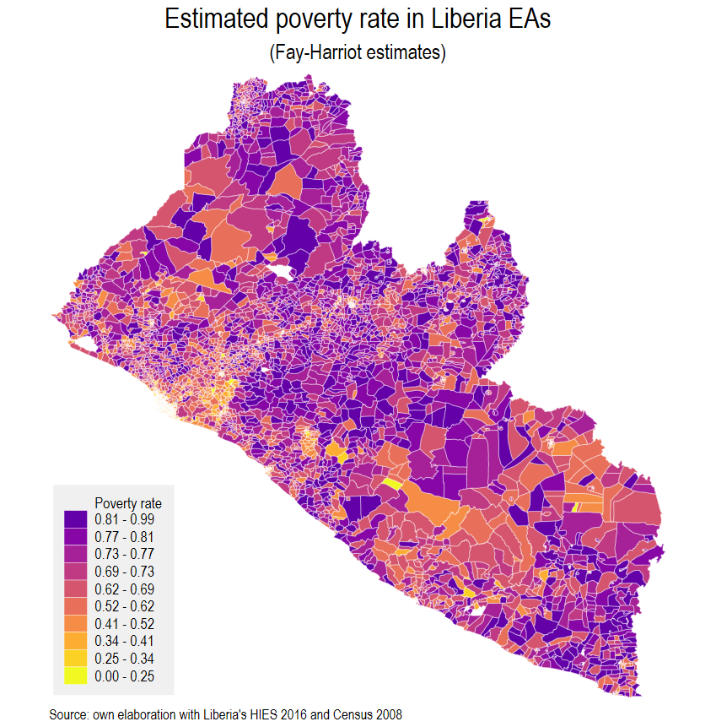
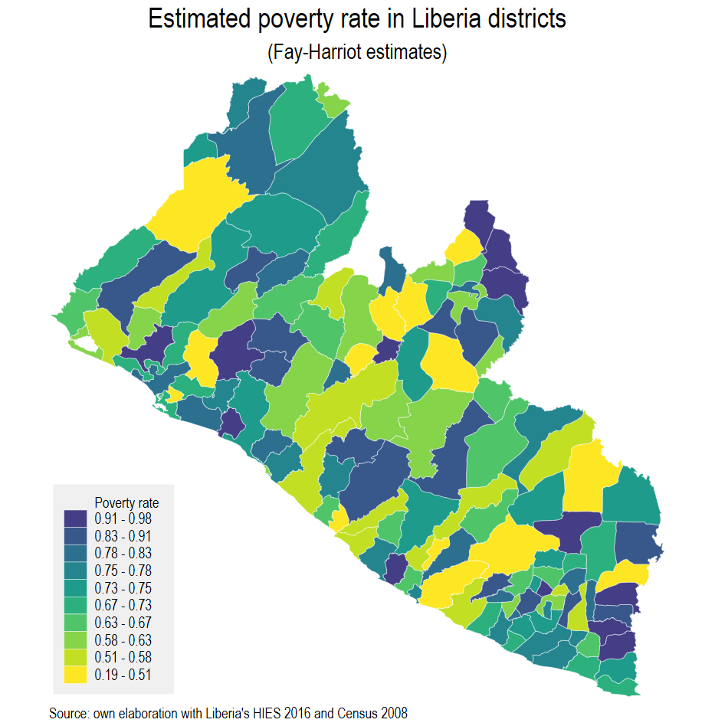
When data is available at a lower level than the reporting one FH estimates can be aggregated to higher levels with corresponding estimated MSE
Unit-level SAE wasn’t possible
Liberia’s survey is from 2016
Liberia’s Census is from 2008
We model the spatial distribution of poverty in the corresponding survey year
The method is ideal for off-census years, but since we use less information for the model it yields noisier estimates than unit-level SAEs

Slide 13
Why is modelling household level welfare using ONLY aggregate covariates (unit-context) less than ideal?
Method is not new; it was originally proposed by Nguyen (2012) relies on an ELL approach
Afterwards, Masaki et al. (2020) updates this to Molina and Rao’s EB.
The challenge with poverty mapping is that the poverty rate is a non-linear transformation of the dependent variable
To have a good model of poverty rates one needs to replicate well the full welfare distribution, not just the mean
This is difficult because area level covariates do not explain within-area variation in welfare across households – the only variation comes from the random error and thus every household in the area has the same probability of being poor
Notes:
Now, what about modeling household level welfare using only aggregate covariates? Why is it less than ideal?
The method isn’t new. For poverty measurement it was introduced by Nguyen, not Minh, in 2012 in an application in Vietnam. Masaaki et al. then update the method using EB methods
The challenge here is that poverty is a non-linear transformation of the dependent variable. Consequently, to accurately measure poverty rates we need to replicate the full welfare distribution, not just the mean of the dependent variable which is where EB helps.
Replicating the full welfare distribution is unlikely since area-level covariates do not explain variation in welfare across households within a given area, hence the ONLY variation across households comes from a random error which in expectation is 0 and thus everyone within the area is expected to have the same poverty rate

Slide 14
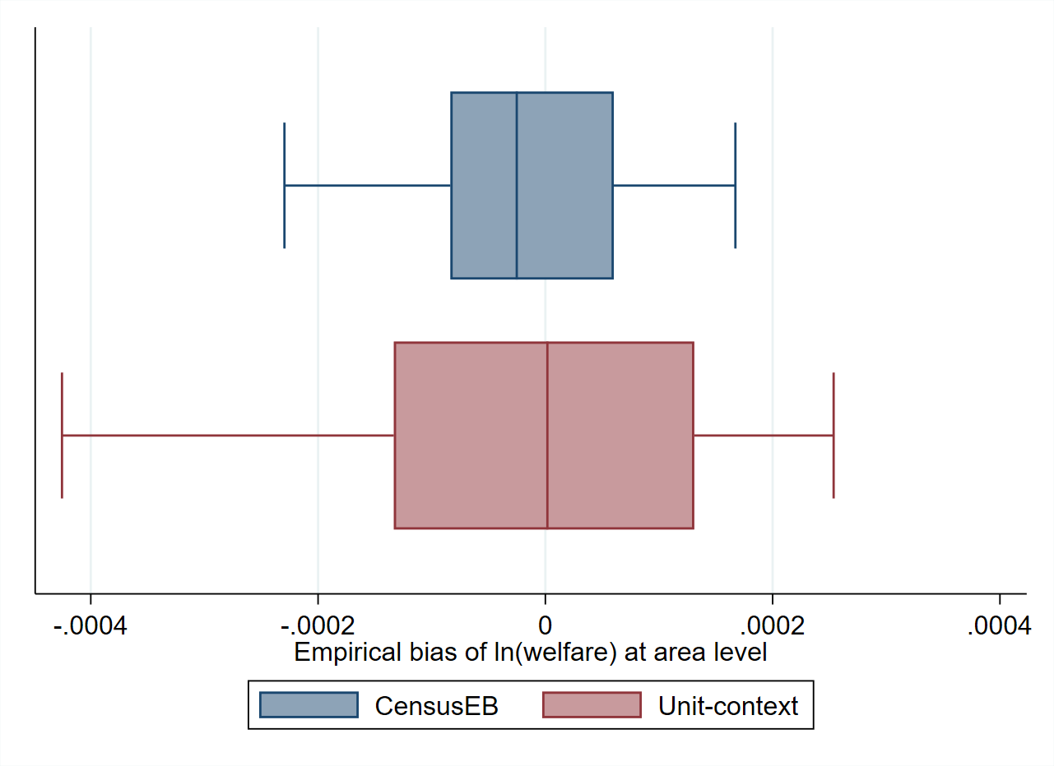
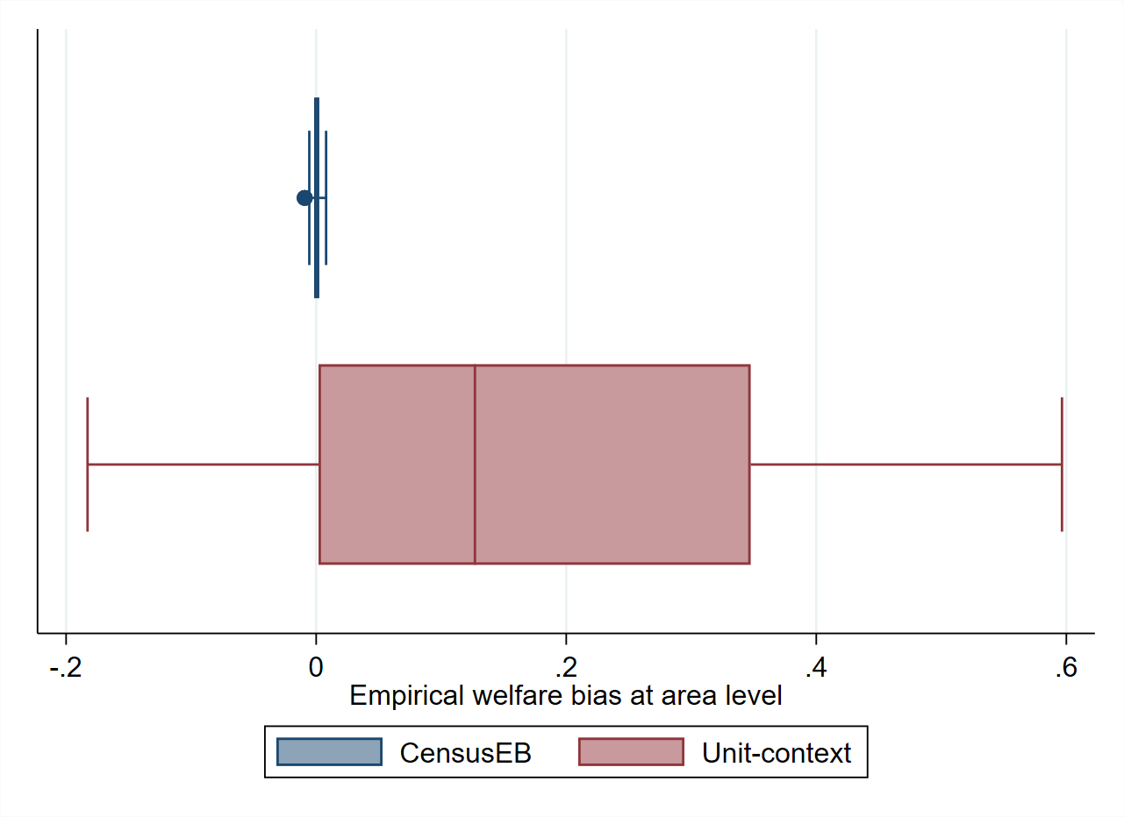
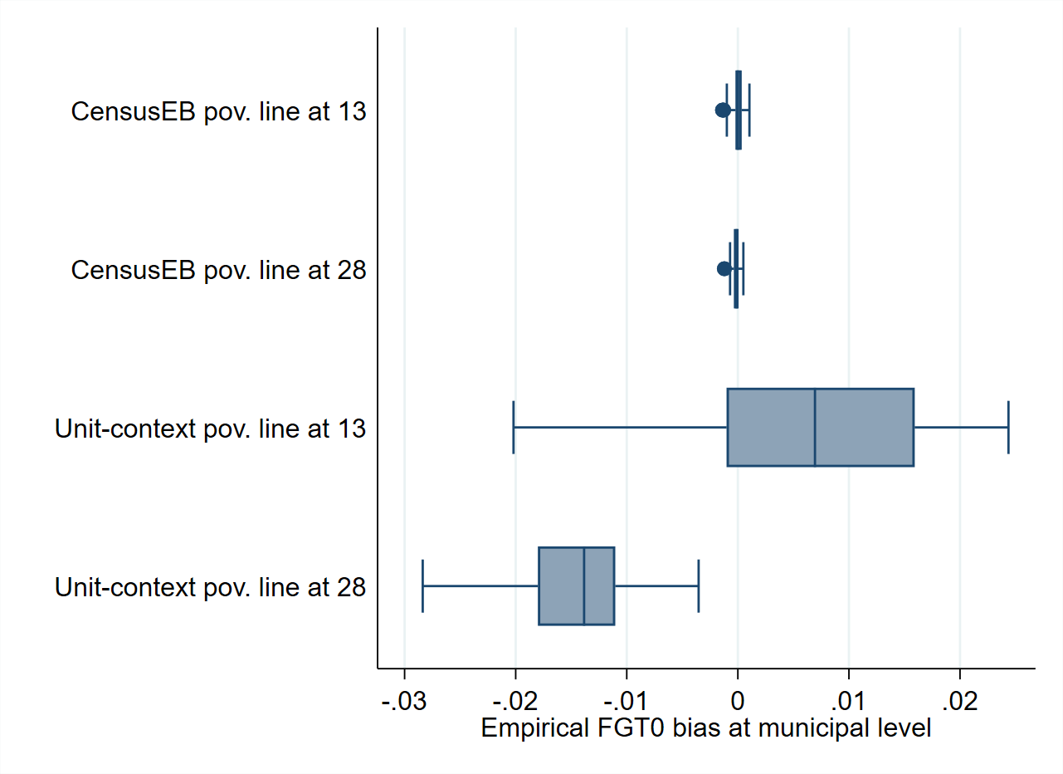
Household models using ONLY aggregate covariates work relatively well for the mean of the dependent variable, but not transformations
Bias of ln(welfare)
Bias of welfare
Bias of FGT0
Bias of welfare
EB ensures that the estimates of the mean of the dependent variable are BLUP
It does not guarantee the same for the transformed variable or for non-linear parameters like poverty
For poverty, just because it may do well at a given poverty line does not mean it will do well for another.
The problem is we do not have the true value, as we do in this case and, thus, we do not know when it is hitting the mark or missing it
Notes:
Moreover, Empirical Best methods only ensure that the DEPENDENT variable’s prediction is EBLUP. It does nothing for transformations as you can see in these figures.
On the figure on the left you can see a comparison between a traditional unit-level model, that is where we model household level welfare using household level information and other area level covariates, versus unit-context models where household level welfare is modeled using ONLY area-level covariates. Notice how the median prediction of the natural logarithm of welfare is unbiased for both methods. Ideally we want values to hover around a bias of 0 and for all to be as close as possible to 0.
Since we normally don’t care about the natural logarithm of welfare, but we care about welfare, the figure in the middle shows the resulting bias once we transform the simulated vectors of the nat log of welfare. Notice that now most of the predictions lie above 0, that means the model’s estimates of welfare is upward biased. While the predictions of the nat log of welfare are unbiased.
Now how does this translate to poverty, well it’s a similar story. Because even a broken watch will give you the right time of day if you look at it at the correct moment, we see how the models predict poverty at 2 different thresholds.
In the figure on the right you can see that at a poverty threshold of 13 nearly 75 percent of the areas lie above 0, suggesting an upward bias in the estimates.
However, if we look at it at a different line, 28, now every single area is below 0, so it yields downward biased estimates of poverty. Notice how the models using household covariates do not have this problem since these are able to better replicate the full welfare distribution.
This implies that modelling household level welfare with ONLY area level covariates is flawed and since we don’t have the true estimates we are unlikely to know in which direction the bias is, it may also differ depending on the area. Also, just because it may work for one poverty line, it doesn’t mean it’ll work for others.

Slide 15
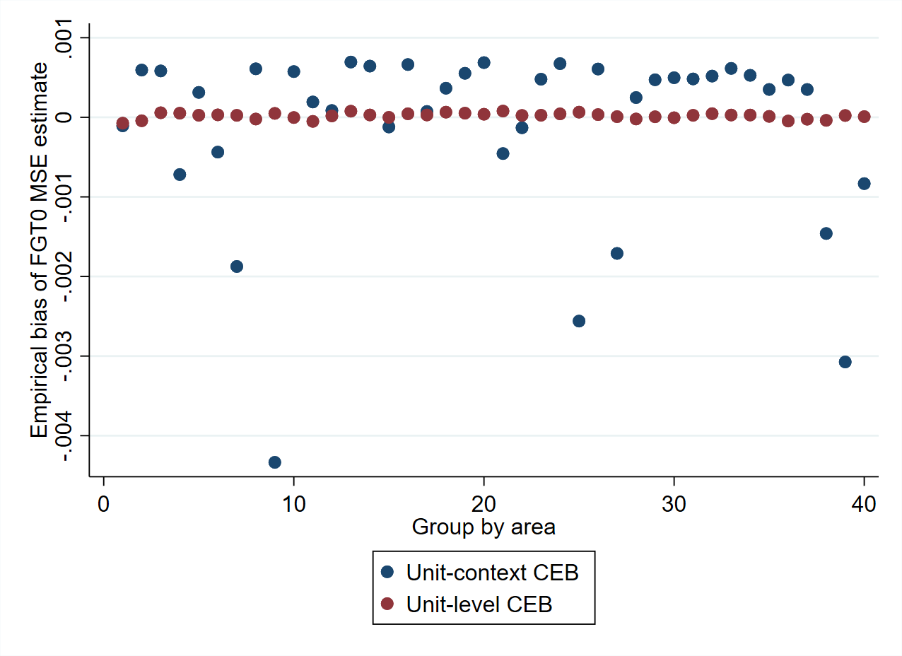
Parametric bootstrap, commonly used for unit-level models, is inadequate for estimating the noise of unit-context models
The empirical MSE serves as the “true” MSE
It is the output of 1,000 populations under which for every population we obtain an estimate of poverty and the squared difference between the estimates and the truth the average yields the empirical MSE
To measure the bias of the noise estimates, under each of the 1,000 populations we obtain the MSE estimate using a parametric bootstrap
Under unit-context models, one can produce biased poverty estimates but may be presented as being very precise
Notes:
- When we do small area estimation a key output is the noise of the poverty estimates. That noise is also an estimate, which under the newer methods used are obtained via a parametric bootstrap.
- An additional concern is the noise estimates in these models which is likely flawed. These simulations rely on replicating the exact process followed for the parametric bootstrap which relies on generating populations using the assumed data generating process. However, since unit context models assume that household level welfare doesn’t depend on household level covariates it will yield poor estimates of the true noise of the method. For some areas it will yield an upward biased estimate of the noise while for some it will underestimate the noise by a considerable amount. Notice how the model using household covariates doesn’t suffer from the same problem.
So, what alternatives do we have?

Slide 16
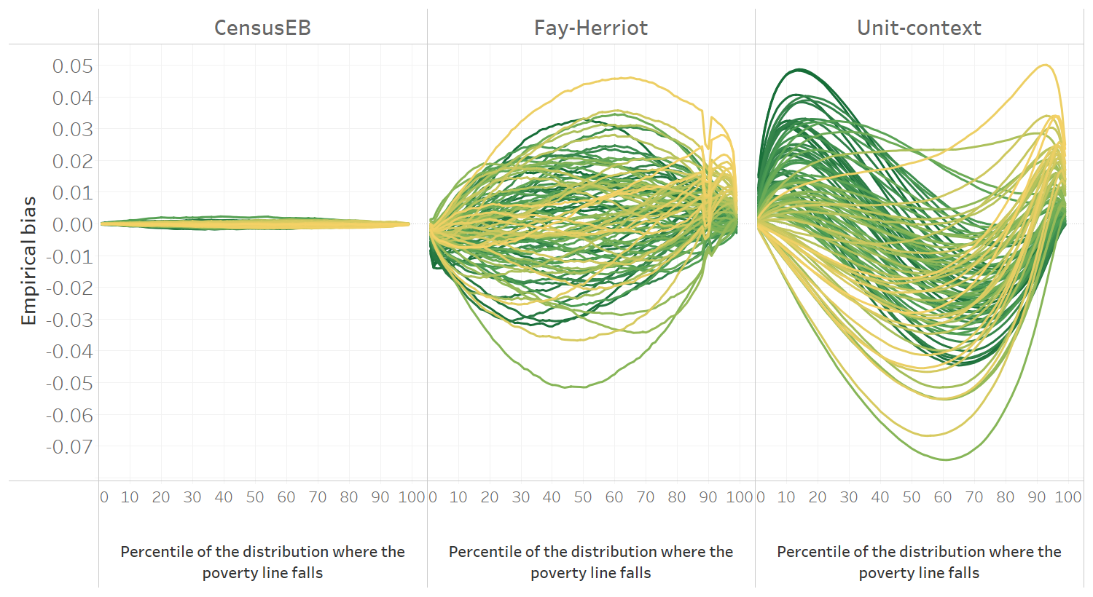
Fay-Herriot and unit-context models (hh model with only area level variables) yield models with considerably more bias than unit-level models
Simulation based on 1,000 populations. Each line corresponds to one of the 100 areas. The x-axis represents the percentile on which the poverty line falls on, and the y-axis is the empirical bias.
Notes:
Compared to models where we model household level welfare with household level characteristics, Fay-Herriot and unit-context models yield estimates with more bias
These simulations are similar to the previous ones. The X axis corresponds to the poverty line used, and the lines correspond to each of the given areas. I focus on areas, because at the end of the day we want to get accurate estimates at the area level.
First thing to note is the small bias of CensusEB estimates obtained from a household model using household characteristics. The bias is small for all areas and for all poverty lines.
The Fay-Herriot models show a lot more bias, and they also require us fitting a new model for every single threshold, since we model poverty directly
Household level models using only area level covariates do a poor job of replicating the welfare distribution and consequently it is not surprising that they are quite biased across the different lines and areas. Note that depending on the percentile the threshold falls upon, the bias could be upward or downward, which could lead to re-rankings.

Slide 17
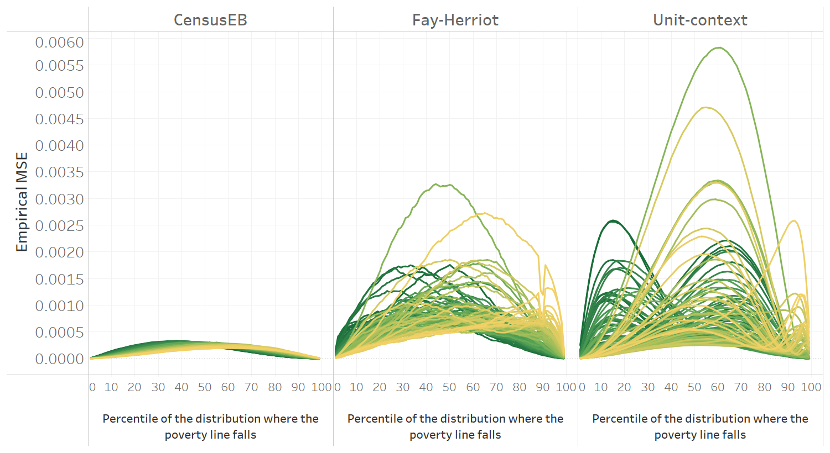
There is no clear improvement of empirical MSE in unit-context models (hh model with ONLY area level covariates) relative to Fay-Herriot models
Simulation based on 1,000 populations. Each line corresponds to one of the 100 areas. The x-axis represents the percentile on which the poverty line falls on, and the y-axis is the empirical MSE.
Notes:
- When it comes to the model’s noise, once again CensusEB estimates outshine all others. Not surprising since they use a lot more information and follow the assumed data generating proces. However, despite using more information than fay herriot models, modelling household welfare using only area level covariates doesn’t seem to improve the overall MSE as you can see here. They yield very similar noise levels. Note that this is the model’s true empirical noise, not estimates. Which as we showed before are flawed for unit-context models.

Slide 18
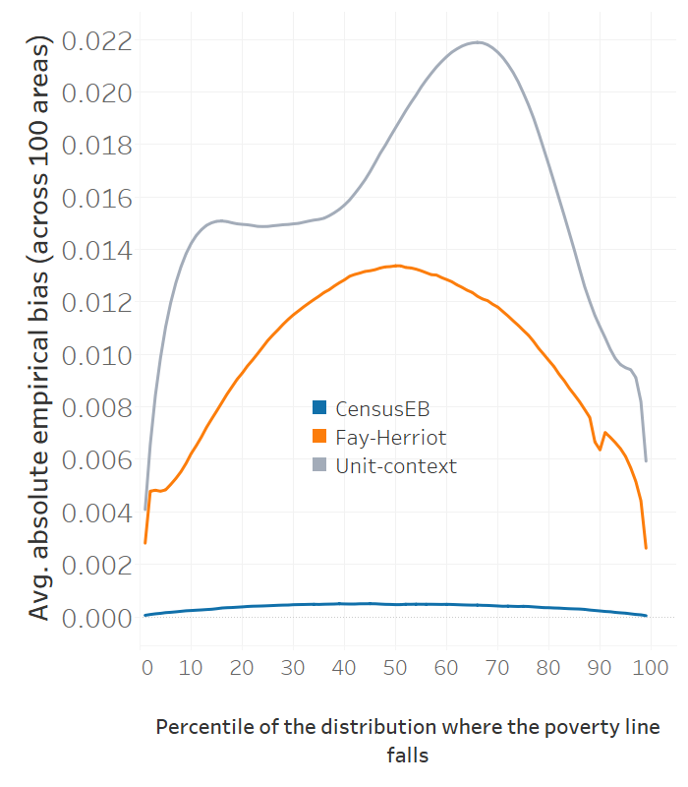
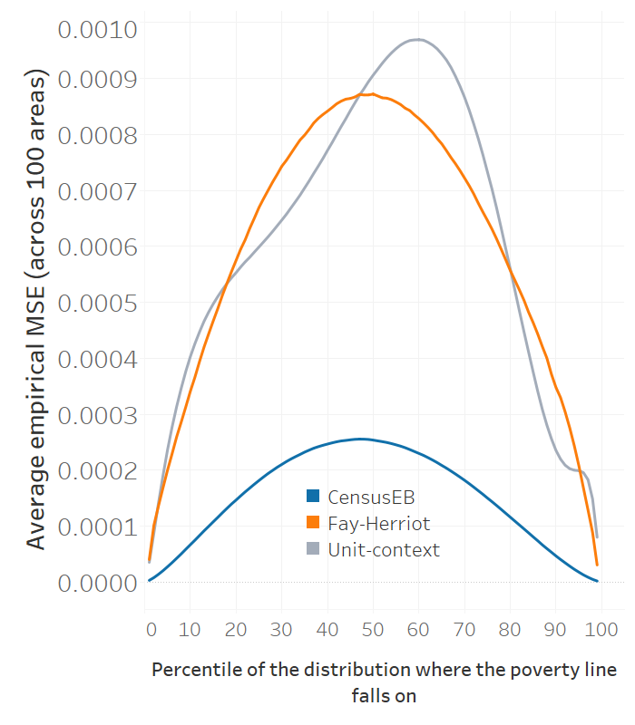
Area level models, dating back to 1979, are still the go-to method for off- census years
And less noisy than unit-context models like those of Masaki et al (2020), Lange, Pape and Putz(2018) and Nguyen (2012)…
Notes:
When we aggregate across areas a similar picture emerges. Fay-Herriot estimates are less biased and have similar noise levels to models where household level welfare is modeled only using area-level covariates.
So, given the bias of the estimates as well as the fact that the noise estimate of the method is also biased, we do not recommend models where household welfare is modeled using only area level covariates for poverty mapping.

Slide 19
Machine learning based poverty maps have become a popular alternative to traditional small area estimation methods
The estimates are obtained through different methods, although gradient boosting has been perhaps the most popular
Still depend on a model at a given area level where the left-hand side variable is some form of poverty indicator for the area
Covariates used are usually satellite derived yet may include any area level covariate such as admin data or census aggregates
The method’s quality will often depend on how well the model fits the data
Literature has yet to offer an approach for estimating the noise of the method
Notes:
Well, what about machine learning based poverty maps?
These have become quite popular, although in most cases they’ve modeled an asset index value and not necessarily head count poverty
They still depend on a model at a given area level, where the dependent variable is some form of poverty indicator for the area
The method’s quality is very dependent on how well the model fits the data
It relies on multiple models fit to the data where between fits, adjustments are made to get better predictions. At the end it joins the fits to achieve a better prediction. It’s not just an average of the fits, it actually adds the fits…it is an ensamble method

Slide 20
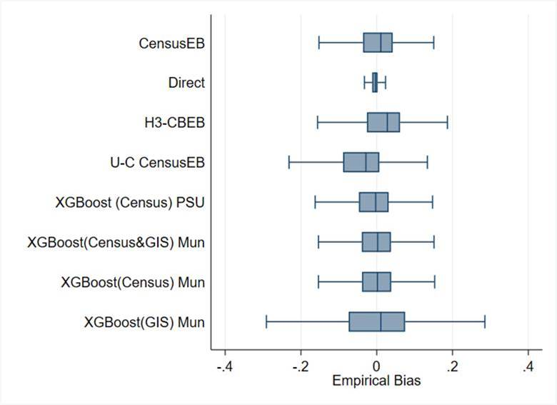
How do machine learning approaches compare to more traditional SAE? A validation with real world data...
FGT0 Bias (mun. level for 1,865 mun.)
Still work in progress… Working Paper coming soon
All methods rely on census household and/or area aggregate covariates, unless stated otherwise
Notice the bias of the different methods
Direct estimates are the least biased
Notice how the box-plot for unit context models, those that model household level welfare using only area level covariates, is downward biased
XGboost yields good results. In some cases as good as censusEB
Results for XGboost from models using just GIS covariates are less stellar
Source: Corral, Henderson, Segovia, and McGee (upcoming)
Mexican intra-censal survey used as a census for design-based simulation based on 500 samples.
Notes:
To my surprise, ML methods do very well
Here I have a census data with an income measure, so we can compare to the true poverty rates. From this data we drew 500 survey samples a la LSMS. For each sample we obtained small area estimates at the municipality level, so for every municipality I have 500 poverty estimates. These small area estimates are compared to the TRUE value in order to get a sense of each method’s empirical bias and noise.
Notice how, the direct estimates have the smallest bias. They are design unbiased, although quite noisy as you’ll see in the next slide.
We fit a few gradient boosting models
The first is at the PSU level, where on the LHS I have poverty rate. On the right hand side we have census aggregates at the psu level and above. Things like share of population employed, share of population with secondary education, share of population owning a certain asset, etc.
The second model is done at the municipality level since in many cases getting access to psu aggregates may not be possible
Here we try a few variations…
First, we try the model where among the candidate covariates we have census aggregates and GIS aggregates…all at the municipality level
The we try using only census aggregates and finally only GIS aggregates
Notice how the gradient boosted estimates are well aligned to the CensusEB model which is our gold standard, well all except the one using just GIS covariates
Also notice how using real world data the estimates where household welfare is modelled using ONLY area level covariate) are downward biased

Slide 21
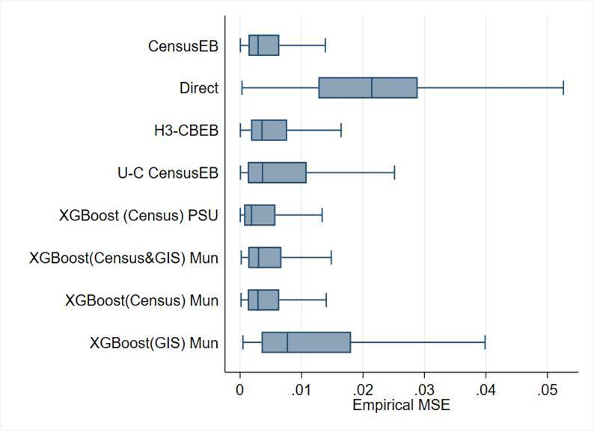
How do machine learning approaches compare to more traditional SAE? A validation with real world data...
MSE (mun. level for 1,865 mun.)
Notice the MSE of the different methods
Direct estimates are the least biased, but noisiest
XGboost fit at the municipal level with just GIS covariates is the second noisiest
CensusEB, as expected, shows the smallest MSE, followed very closely by XGboost fit at the PSU level with just census aggregates
XGboost in this scenario outperforms unit-context models as those presented by (Masaki et al. 2020) by a considerable margin
Source: Corral, Henderson, Segovia, and McGee (upcoming)
Mexican intra-censal survey used as a census for design-based simulation based on 500 samples.
Notes:
Most encouraging, the empirical noise measured by the MSE for machine learning approaches is also closely aligned to CensusEB estimates, our gold standard. Note how the empirical noise is lower than the one where household welfare is modelled using only area level covariates (the same covariates used in the machine learning approach).
To me, this is quite the result and encouraging since fitting these gradient boosted models is relatively quick and simple. The method does well, but it depends on the data you feed it, and thus the publicly available GIS covariates don’t do so well.

Slide 22
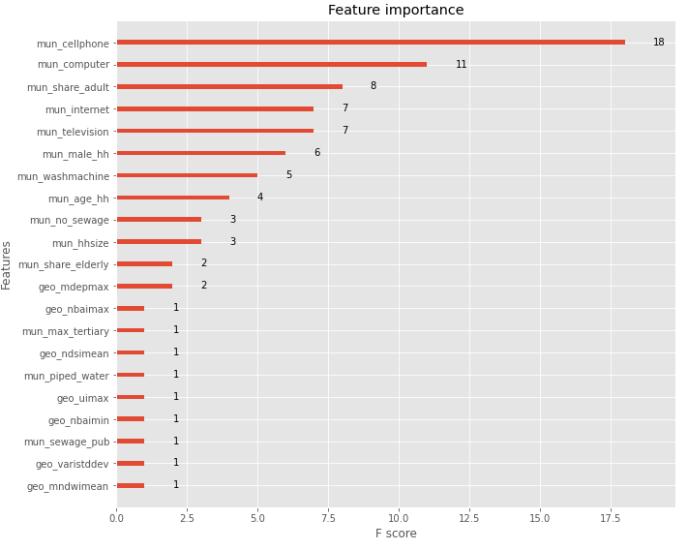
It all depends on the quality of the data! Publicly available GIS variables are not preferable over other area level information that could be derived from the census or other admin data
The model works best with census data aggregates
When combining census aggregates and GIS covariates the method leans towards census aggregates
The empirical MSE of the gradient boosting models is smaller when only using census aggregates
In this scenario it suggests that census aggregates are better than GIS at explaining the variation of area level poverty
Covariates with mun_ prefix are derived from the census, geo_ are GIS covariates…
Notes:
The model combining census and GIS covariates yields an interesting insight, the most important covariates for modeling poverty at the municipality level in this case are mostly from the census, and GIS covariates only show as the 12th most important covariate. Notice that for this we only relied on publicly available GIS data given to us by INEGI. Of course, if we had better GIS data this could change.
evi: Enhanced Vegetation Index
ndvi: Normalized Difference Vegetation Index
ndbi: Normalized Difference Built-up Index
bu: Built-up Index
sr: Simple Ratio
arvi: Atmospherically Resistant Vegetation Index
ui: Urban Index
ibi: Index of biological integrity
ndwi: Normalized Difference Water Index
mndwi: Modified Normalized Difference Water Index
nbi: New Built-up Index
brba: Band Ratio for Built-up Area
nbai: Normalized Built-up Area Index
baei: Built-up Area Extraction Index
ndsi: Normalized Difference Snow Index
vari: Visible Atmospherically Resistant Index
savi: Soil Adjusted Vegetation Index
osavi: Optimized Soil Adjusted Vegetation Index
ndmi: Normalized Difference Moisture Index
mdea = Altitude from digital model
mdep = slope from digital model

Slide 23
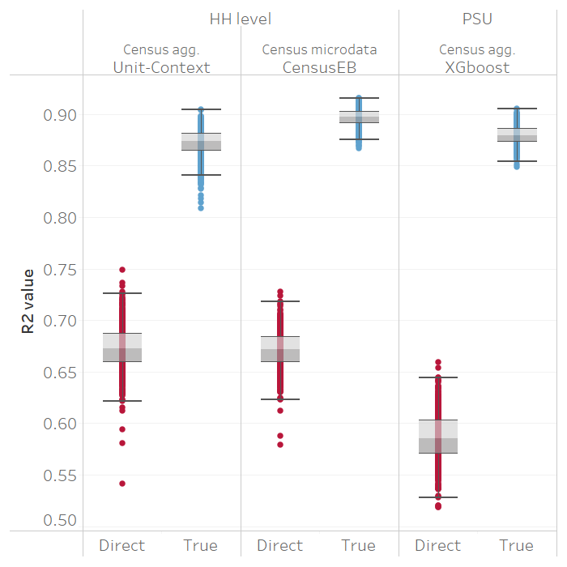
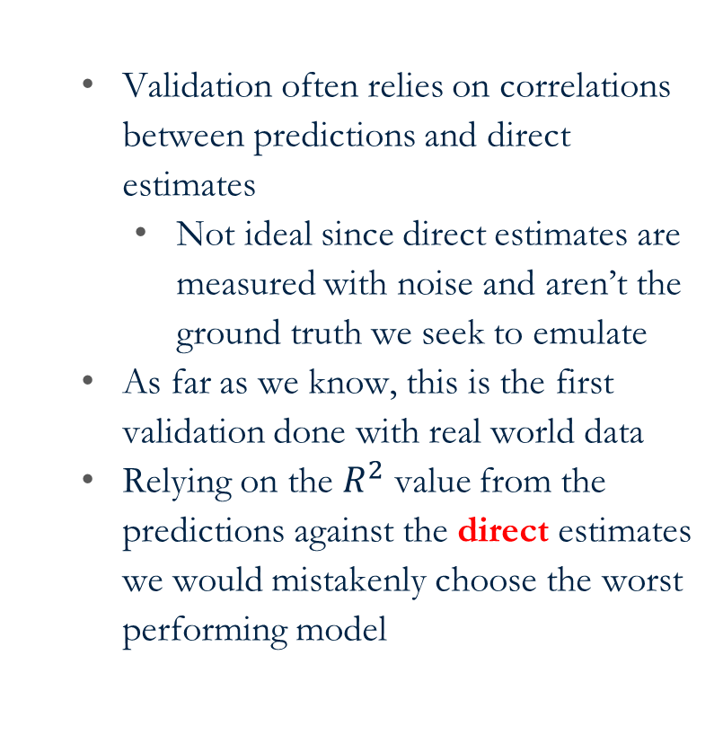
Relying on alternative validation methods could be mistaken: The coefficient of determination or $R^{2}$ is the most used metric for validating poverty maps generated using machine-learning methods
Validation often relies on correlations between predictions and direct estimates
Not ideal since direct estimates are measured with noise and aren’t the ground truth we seek to emulate
As far as we know, this is the first validation done with real world data
Relying on the $R^{2}$ value from the predictions against the direct estimates we would mistakenly choose the worst performing model
Source: Corral, Henderson, Segovia, and McGee (upcoming)
Notes:
-

Slide 24
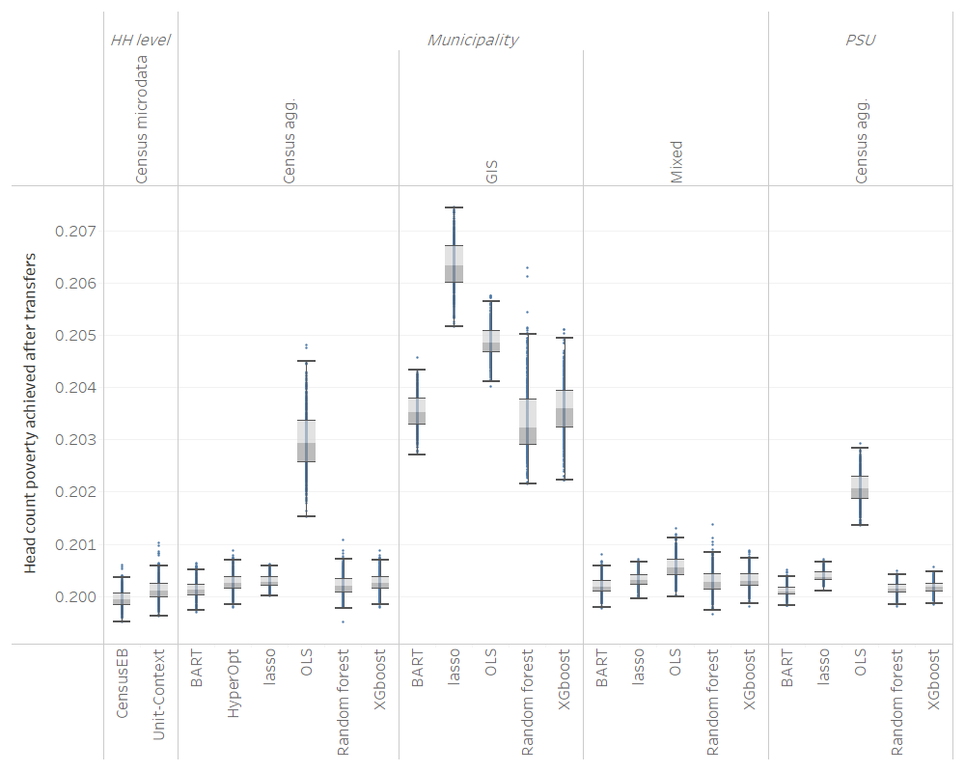
Does it matter for spatial targeting?
Transfer budget is equal to the poverty gap of the population (census)
Original poverty is 25%
Using the true poverty ranking we achieve poverty of 19.9% by giving all in the poorest areas the same transfer amount (budget/total number of poor)
In this scenario, despite bias and noise, the rankings are not too affected and thus results are decent.
There’s no guarantee this will hold everywhere!
Some methods do a better job than others, but in the end, something is better than nothing!
Source: Corral, Henderson, Segovia, and McGee (upcoming)
Notes:
So…to conclude, at the end of the day why do we do these maps? Usually to improve some form of spatial targeting and prioritize across areas. Here, since I had the true poverty rate for each municipality I know what is the benchmark against which I can compare my models. So, I take my budget, I sort my municipalities according to their true poverty status, within a municipality I give everyone the same amount of money. Then I move to the next most poor municipality and so forth until I run out of cash. Under each set of small area estimates of poverty I do the same. I rank the municipalities by their predicted poverty rate, and then give the money to everyone in the municipality (I add this amount to the real per capita income), so across simulations only the rankings change since these come from the different sets of small area estimates.
Well, the lowest poverty rate I can achieve by doing this using the TRUE poverty ranking is 19.9%, down from 25%
As you can see, even an OLS using GIS covariates will get you a median poverty rate of roughly 20.5, which is ONLY 0.6 percentage points worse than the ideal scenario
Of course, this may be something unique to the Mexican data we’re using and there’s no guarantee it’ll work everywhere.
However, from this the lesson is that although some methods do a better job than others, at the end of the day, something is still better than nothing.

Slide 25
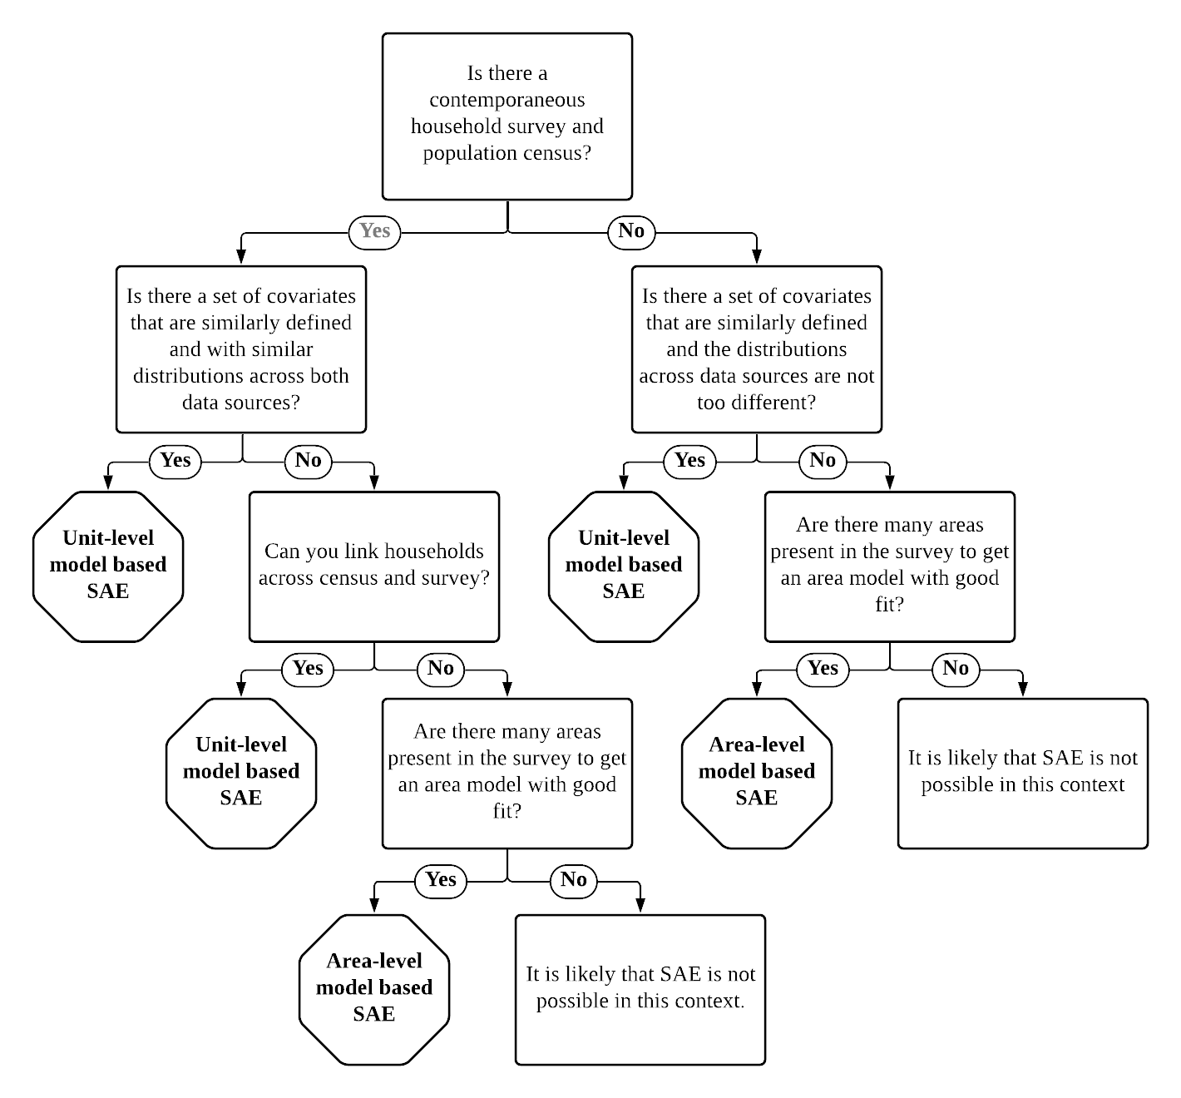
The guidelines present a simple decision tree on what may be the recommended approach for your data environment…as we learn more about other methods, we hope to expand it

